Slide 1
Access and Conservation Easement (ACE) Program
Public Information Session

Slide 2
Meeting Agenda
Overview - NYS Canal System & Reimagine the Canals
Fall Fishing Program Background
ACE Program Overview
Next Steps
Question and Answer Period

Slide 3
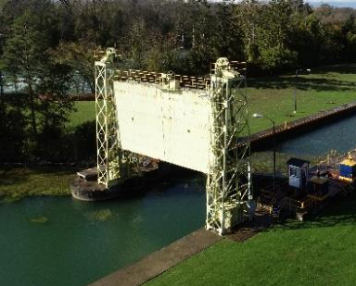
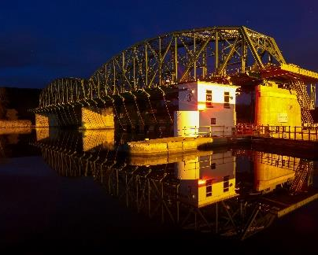
NYS Canal System (500+ miles long)
Guard Gates
Locks
Movable Dams

Slide 4
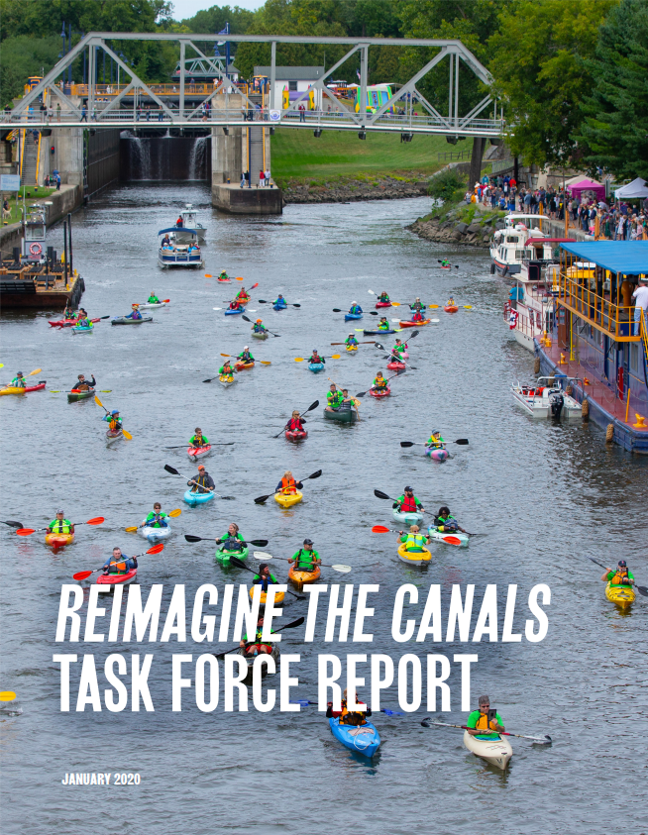
Reimagine the Canals
The NYS Canal Corp (Canals), a subsidiary of the New York Power Authority (NYPA) together launched the “Reimagine the Canals” initiative in 2017.
Goal – Enhance Utilization of the Canal to:
Boost local economies
Grow recreation & tourism
Strengthen environmental resiliency
One component is the use of the Canal infrastructure in WNY to increase the vitality of the fisheries in the Canal fed tributaries of Lake Ontario

Slide 5
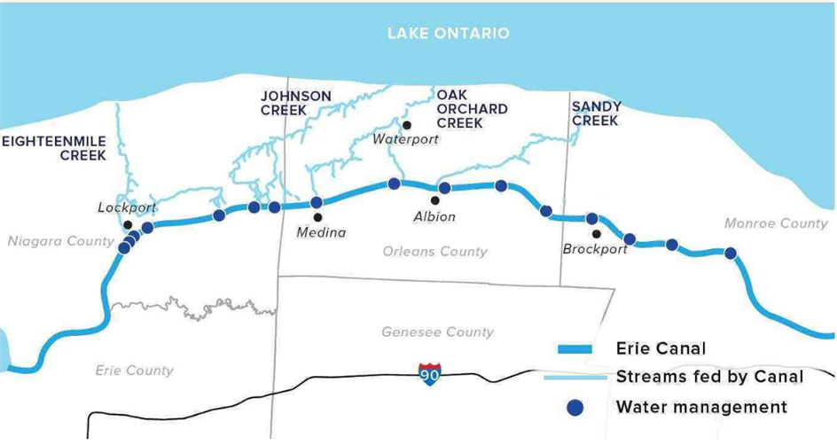
Fall Fishing Program
In 2020, NYPA and the Canal Corp, in partnership with NYS Department of Environmental Conservation (DEC), launched the Fall Fishing Program
Water Releases from the Erie Canal are managed in order to enhance the fisheries in north flowing Lake Ontario tributaries
The releases are designed to:
expand recreational fishing
improve fish habitat
promote larger spawning migrations
provide more predictable angling
protect fish from predatory angling practices

Slide 6
Fall Fishing Program
Areas of focus include Oak Orchard Creek, Sandy Creek, Eighteenmile Creek and Johnson Creek
The 2020 pilot program was a success and was continued for the 2021 season
A key goal is to boost the local economies of Orleans, Monroe and Niagara counties through angling tourism
In 2021, vehicles from 34 states were observed, as well as Canadian and other international visitors
Program’s success highlighted the need for more public access along these streams to ensure a place for all to enjoy the angling experience

Slide 7
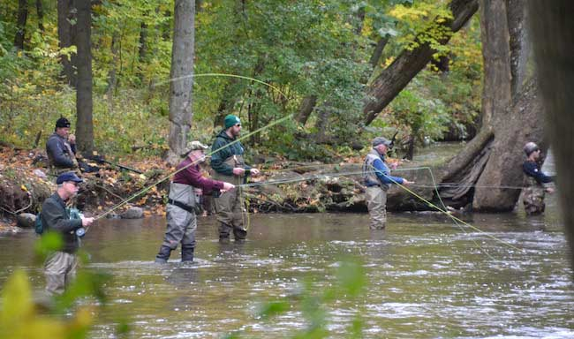
ACE Program Overview
The Access and Conservation Easement (ACE) program will provide compensation to landowners to secure public fishing access and other conservation rights
Conservation rights could include development rights, timber rights, erosion control access, stream habitat improvement, or other rights that provide the NYS DEC the ability to protect and improve fish habitat
Up to $1.25M over ten years will be spent on this program
Rights transferred will be negotiated with each landowner separately and can differ
Easements will reside with NYS DEC ensuring public access, fish habitat and water quality are improved

Slide 8
ACE Program – Area of Interest
To be considered for the ACE Program, the respondent’s property should be part of the Request For Expressions of Interest (RFEI) Area:
Eighteenmile Creek (Niagara County) – Downstream of Burt Dam to Lake Ontario
Johnson Creek (Orleans County) – Downstream of Lyndonville Dam to Lake Ontario
Oak Orchard Creek (Orleans County) – Downstream of Waterport Dam to Lake Ontario
Sandy Creek - East and West Branches and main stem (Monroe and Orleans counties) – From the Erie Canal to Lake Ontario

Slide 9
ACE Program – Selection of Parcels
Parcels will be selected by factors including, but not limited to:
Length of waterfrontage
Land Topography
Proximity to existing public access locations and public parking areas
Value of the rights conveyed/sold will be determined by an independent appraiser
Appraisal will include current property value and a property value without the negotiated rights to determine payment

Slide 10
ACE Program - Process
Step 1: Interested landowners respond to this RFEI.
Step 2: NYPA and NYSDEC will assess responses and evaluate each respondent’s property based on the selection criteria.
Step 3: NYPA and NYSDEC will contact selected respondents to discuss participating in the program.
Step 4: An independent appraiser will conduct an appraisal to determine the acquisition price.
Step 5: If acquisition price and other terms of access and conservation easement are agreed upon a purchase agreement will be executed between New York State (acting through the Commissioner of NYS DEC) and the property owner, subject to all required reviews and approvals.
Note: Respondent will have the opportunity to opt out should a final agreement not be reached.

Slide 11
Next Steps
If interested, send the following info via the Response Form that accompanied the RFEI or available by contacting OnTheCanals@nypa.gov:
Name and contact information of property owner
Property address and size
Tributary name
Tax Parcel ID
Description of current land use
Submission deadline: April 4, 2022
Questions? Email OnTheCanals@nypa.gov by March 11, 2022.
Answers will be posted publicly on the Fall Fishing Program website – www.canals.ny.gov/Fall_fishing/index.html

